Slide 1
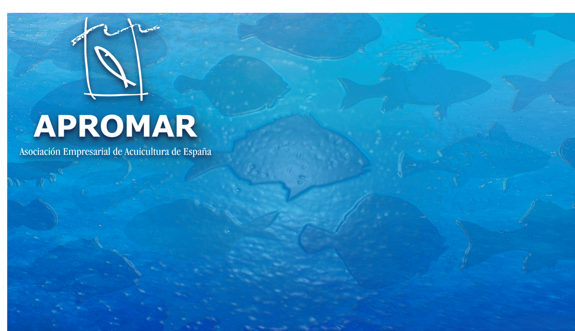
Garazi Rodríguez Valle
Head of Projects Section
garazi@apromar.es
GOVERNANCE, IMPLEMENTATION METHODS AND PRACTICES
ON SPANISH AND EU AQUACULTURE
Sept’19

Slide 2
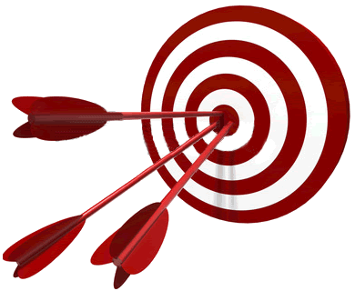
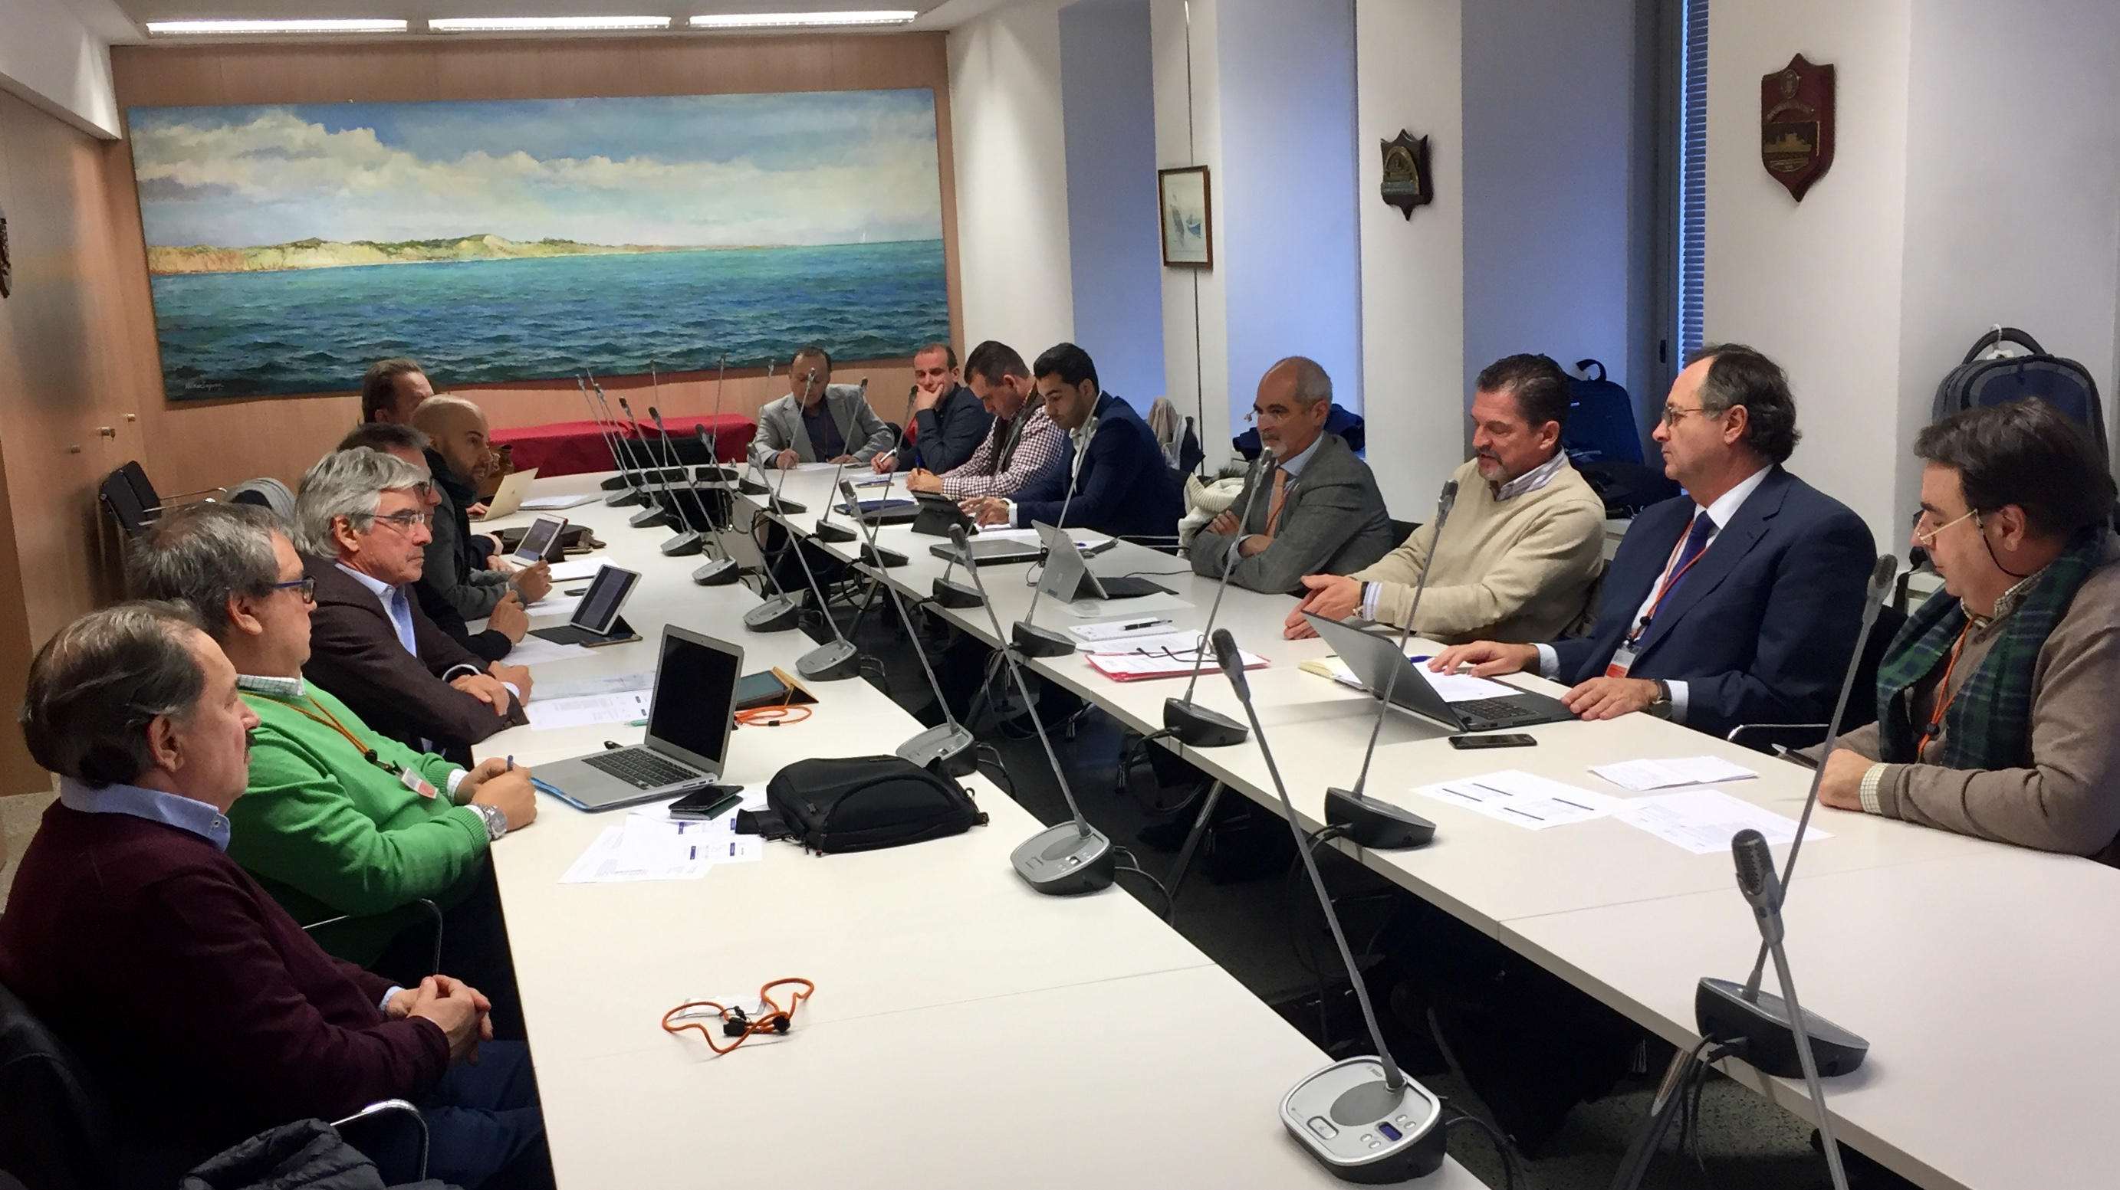
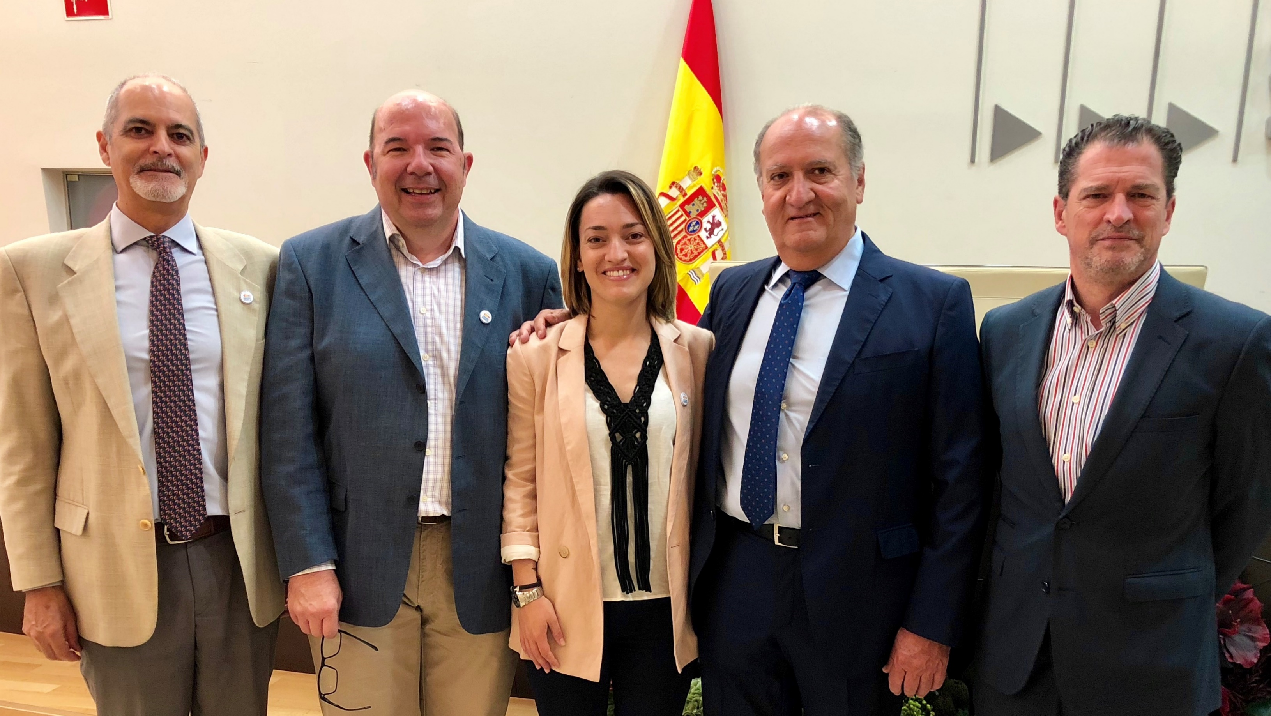
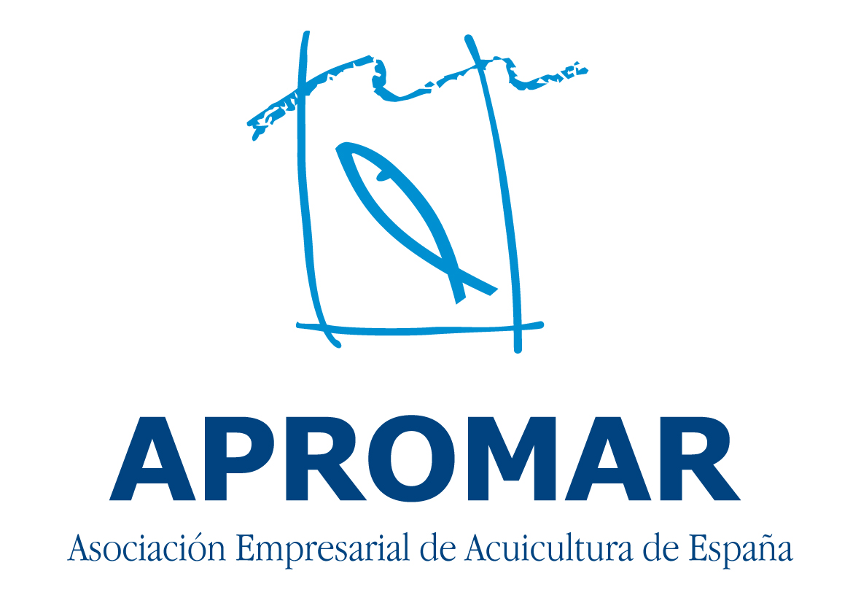
1. APROMAR
Spanish Aquaculture Farmer’s Association (1986)
&
European Producer’s Organisation (OPP nº30)
General Assembly- Board of Directors
Secretariat- Mr. Javier Ojeda
Improve the competitiveness of our members
Promote the sustainable development of the aquaculture sector
Spanish Aquaculture Companies
Aquaculture Goods and Servers Suppliers
Regional Aquaculture Associations
http://www.apromar.es/asociados

Slide 3
1. APROMAR
International and national bonds:
  Very important for APROMAR
  Business associations provides a powerful leverage for APROMAR’s capacities
National (Public)
Ministries
SGP
National (Private)
IEO
International
IBERAVAL
FEADSA
WORKERS UNIONS
RESEARCH CENTERS
PTEPA
Vet + i
Regional Governts
CES
JACUMAR
Agroalim. interprofessionals
AAC & MAC
EESC
IUCN
European Commission
EU Parliament
FAO
FEAP
CEOE
APROMAR
FIAB
BUSINESS EUROPE

Slide 4
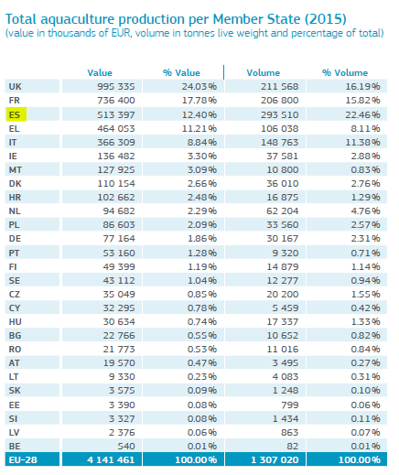
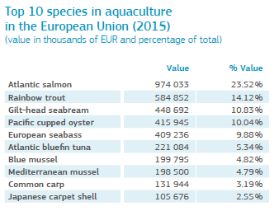
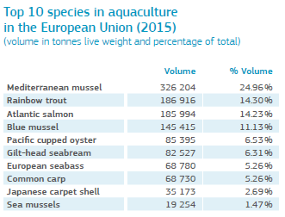
2. INTRO
European Union:
In 2015: Europeans consumed more than twice seafood as much as they produced. EU’s self-sufficiency rate: 46 %
The EU’s production covers more than two thirds of its consumption of pelagic fish and more than half of its consumption of molluscs. It is more dependent on external sourcing for salmonids, crustaceans and other fish
Main aquaculture-producing countries in terms of volume are Spain, the United Kingdom, France, Italy and Greece

Slide 5
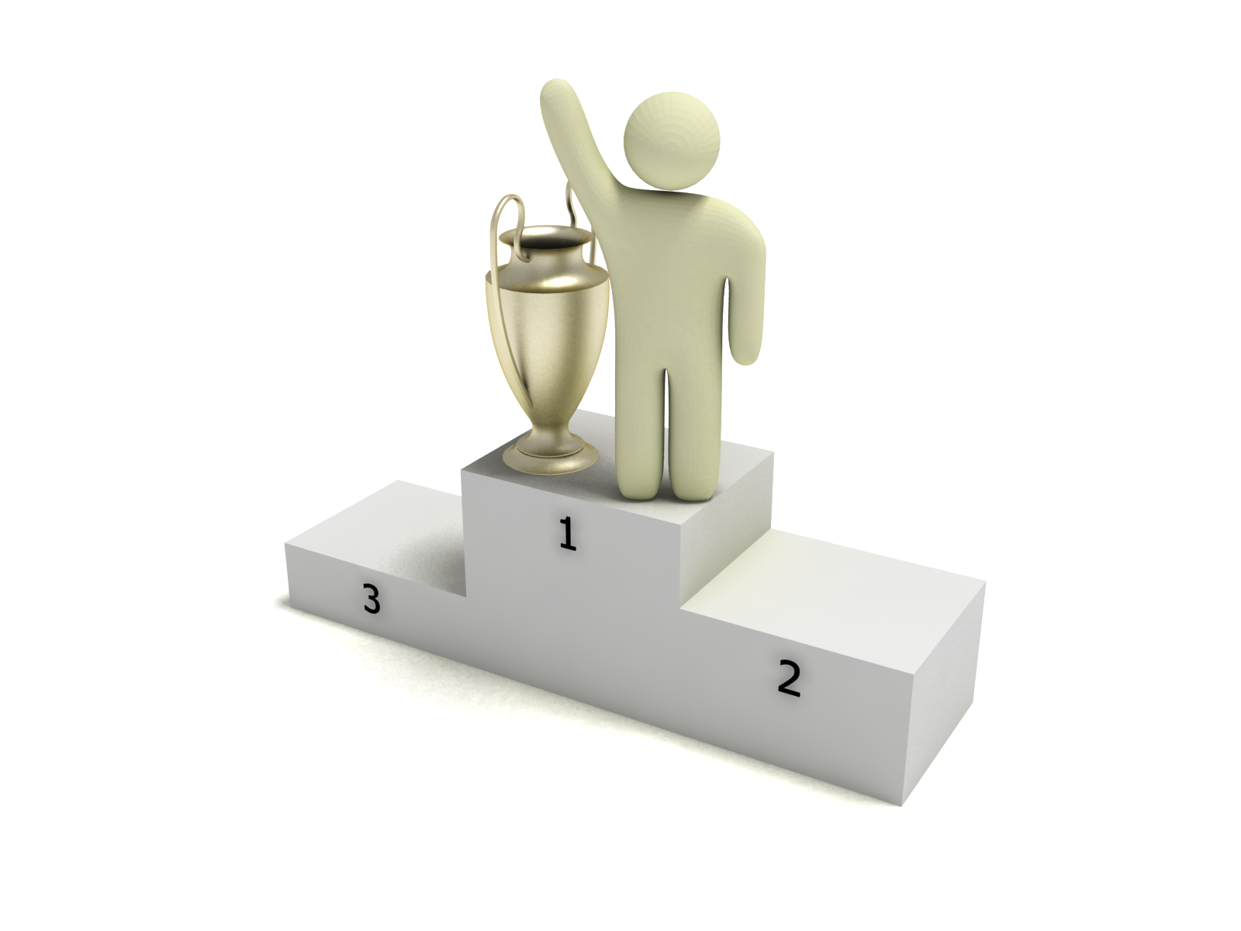
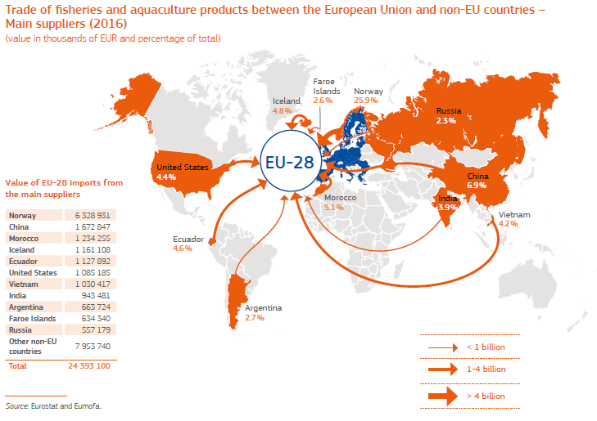
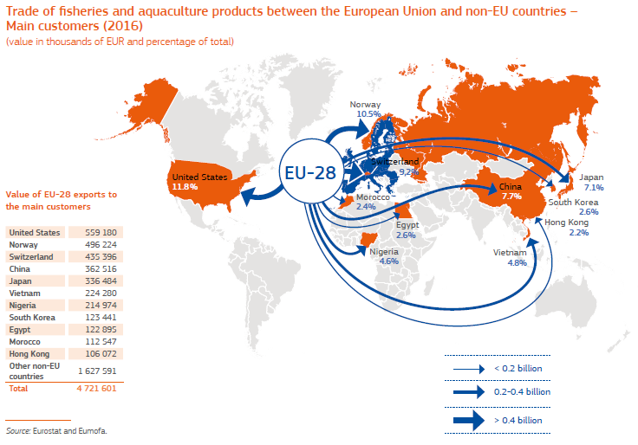
2. INTRO
European Union:
World’s 5th largest Producer of Fisheries and Aquaculture Products
2016:
  1,29 million tons = 4,250 million €
  Record production sea bass in Greece and Spain
Leading trader in terms of value: 29,1 billions in 2014
  Main suppliers: Norway, China, Morocco and Iceland
  Main clients: USA, Norway, Switzerland and China

Slide 6
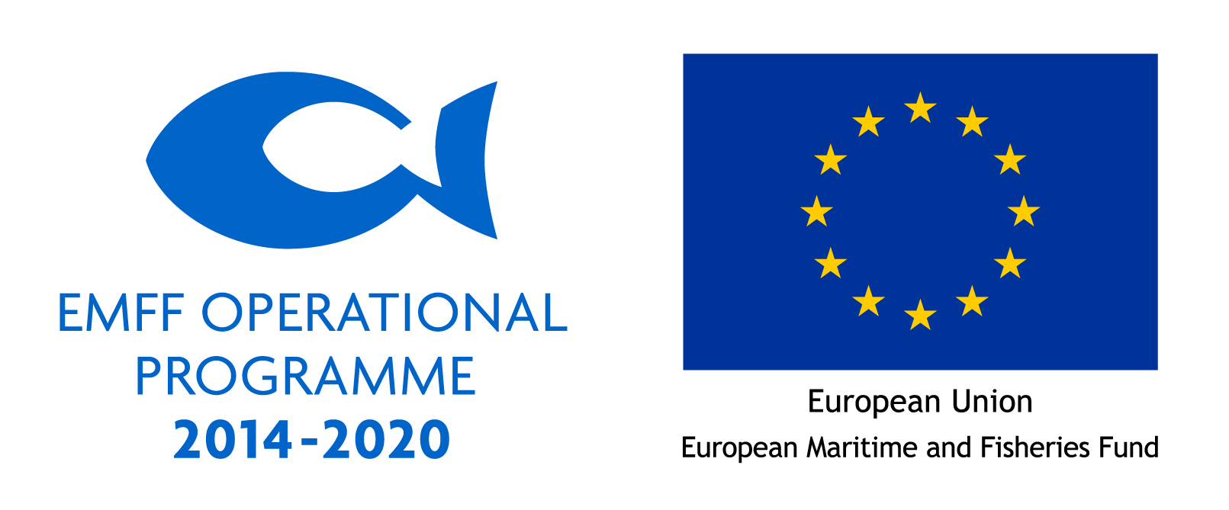
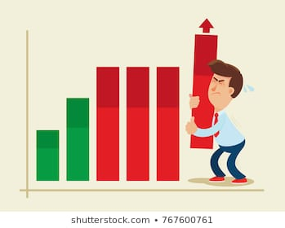
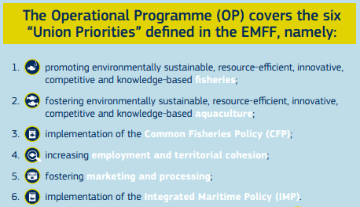
2. INTRO
European Union:
Aquaculture in EU generates 85,000 direct jobs >14,000 (microenterprises)
Small part of EU economy: offers possibilities for growth and job creation both in coastal and inland areas
EU aquaculture production seems stagnant
while it grows in the rest of the world

Slide 7
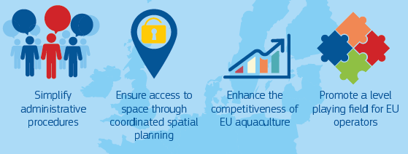
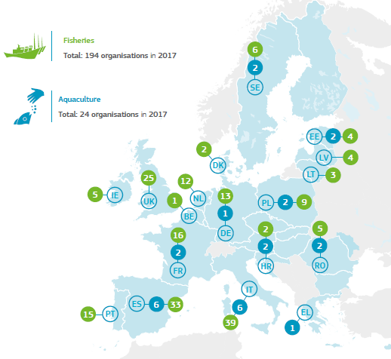
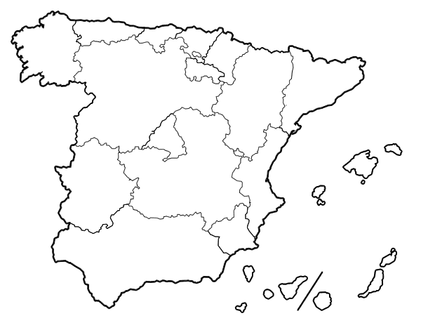
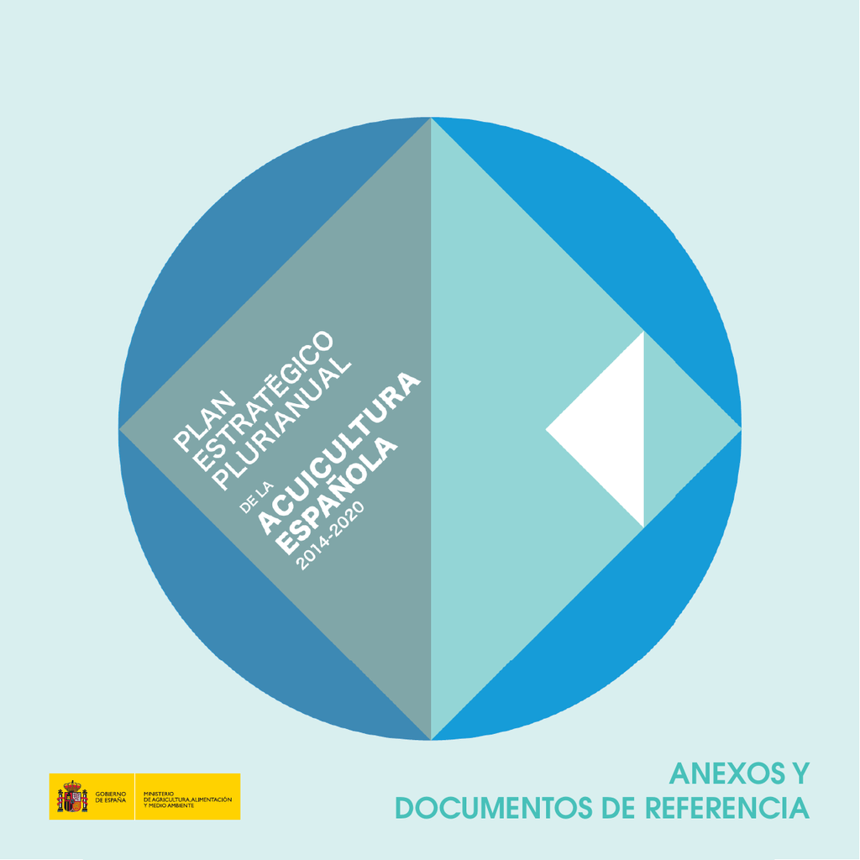
2. INTRO
European Union:
Aquaculture is one of the pillars of the EU Blue Growth strategy:
  Member States > measures in their Multiannuals Plans to achieve:
  To develop the actions > Producer’s organizations> important role
For every European Aquaculture Producer’s Association the main legal framework is:
  EU Common Fisheries Policy (PPC):
https://publications.europa.eu/en/publication-detail/-/publication/08d4994e-4446-11e8-a9f4-01aa75ed71a1/language-en
  EU Common Organisation of the Markets for Fishery and Aquaculture Products (OCM):
https://eur-lex.europa.eu/legal-content/EN/TXT/PDF/?uri=CELEX:32013R1379&from=EN
  European Maritime and Fisheries Fund (FEMP):
https://eur-lex.europa.eu/legal-content/EN/TXT/PDF/?uri=CELEX:32014R0508&from=ES
Spain’s bureaucracy is
VERY complex

Slide 8
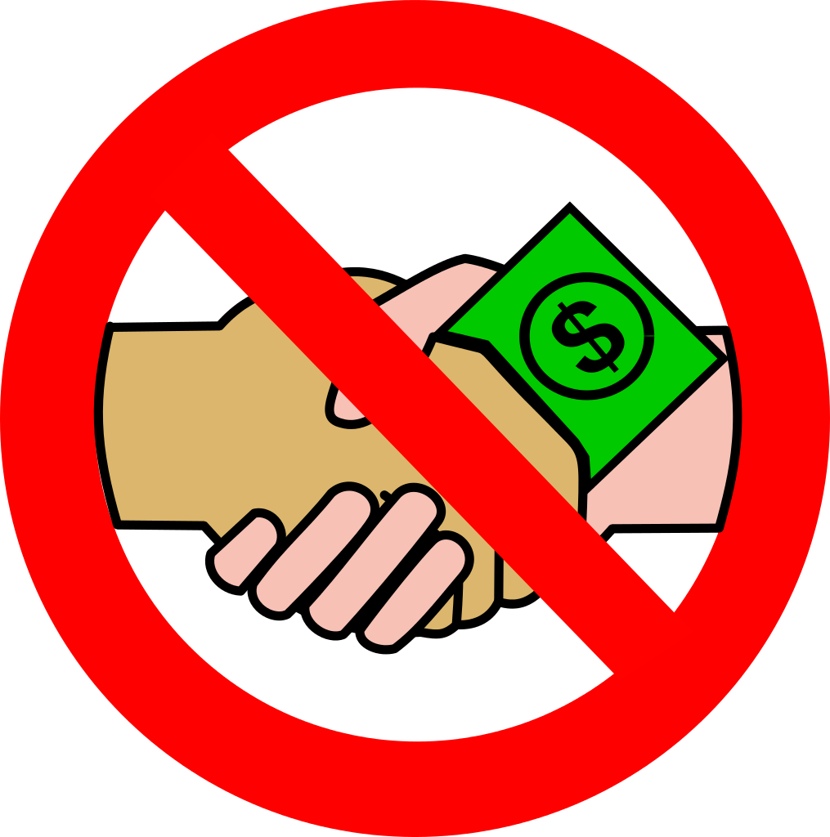
3. MARKETING COMPETITIVENESS
European Union-Producer’s Organizations:
In relation to marketing competitiveness and the methods to stabilize the market prices, it is important to remark that in Europe mechanisms to stabilize market prices do not exist, they are illegal and they are persecuted.
  There are competition rules and authorities to avoid market manipulation
  Stabilisation of prices is not possible
  Only official agricultural and fisheries Producer Organisations have certain advantages on this matter
Spanish Aquaculture Farmer’s Association (1986)
&
European Producer’s Organisation (OPP nº30)
legal advantages:
  Coordinate the production
  Share information
  but NEVER establish minimum prices

Slide 9

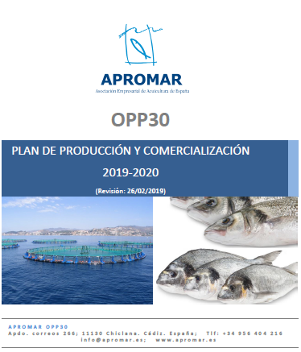
3. MARKETING COMPETITIVENESS
European Union-Producer’s Organizations:
APROMAR > Ministry of Agriculture, Fisheries and food:
Production and Marketing Plan for the next 2 or 3 year
11 Strategic Lines = Measures
Innovation
Fish health and Fish Welfare
Feeds
Collective Bran “Crianza de Nuestros Mares”
Markets and Trade
Training
Economic Sustainability
International relations
Labour Relations
Communication
Promotion

Slide 10
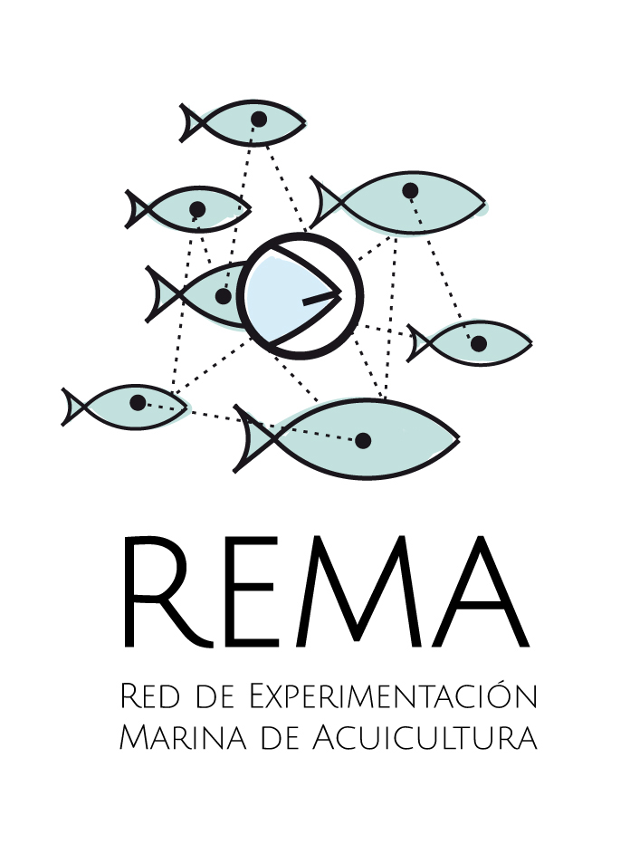
3. MARKETING COMPETITIVENESS
1. INNOVATION
Internal I+d+i department in APROMAR (since 2015) > Aquaculture Marine Research Network (REMA)
Group of innovation experts of main aquaculture companies
Objective of boosting projects that improve best practices, innovation and sustainability of aquaculture production.
This network makes possible to connect: aquaculture farms, universities, innovation and research centers in the same innovation project.
This year we have created a new Focus Group in which our non-producer associates (providers of services to aquaculture)
Innovation
Fish health and Fish Welfare
Feeds
Collective Bran “Crianza de Nuestros Mares”
Markets and Trade
Training
Economic Sustainability
International relations
Labour Relations
Communication
Promotion

Slide 11

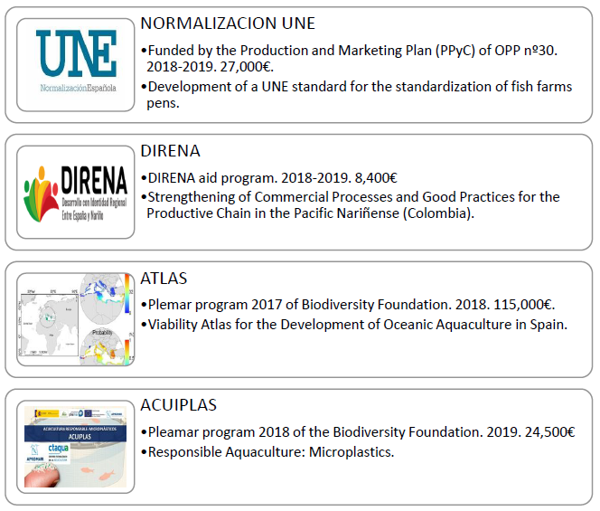
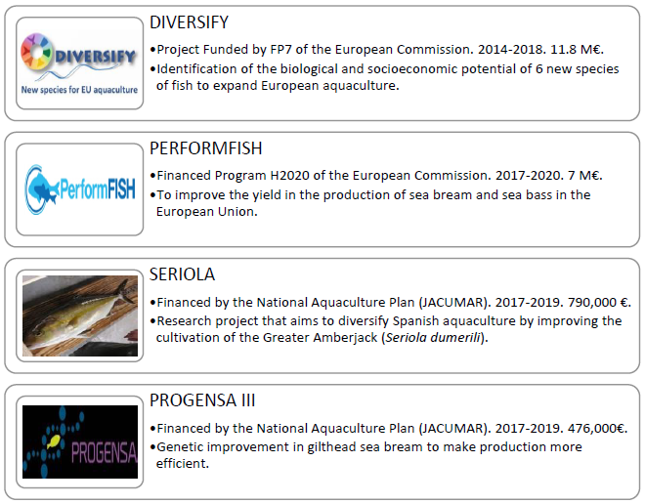
3. MARKETING COMPETITIVENESS
1. INNOVATION
Innovation
Fish health and Fish Welfare
Feeds
Collective Bran “Crianza de Nuestros Mares”
Markets and Trade
Training
Economic Sustainability
International relations
Labour Relations
Communication
Promotion

Slide 12


3. MARKETING COMPETITIVENESS
2. FISH HEALTH AND FISH WELFARE
FEADSA
Goal of improving the health of the Spanish aquaculture sector
Coordinated work between the different Spanish Health Defense Groups of Aquaculture (ADS).
These ADS are a key element for fish health through the establishment of Common Fish Health Monitoring Plans.
http://apromar.es/healthyfishapp/
Innovation
Fish health and Fish Welfare
Feeds
Collective Bran “Crianza de Nuestros Mares”
Markets and Trade
Training
Economic Sustainability
International relations
Labour Relations
Communication
Promotion

Slide 13
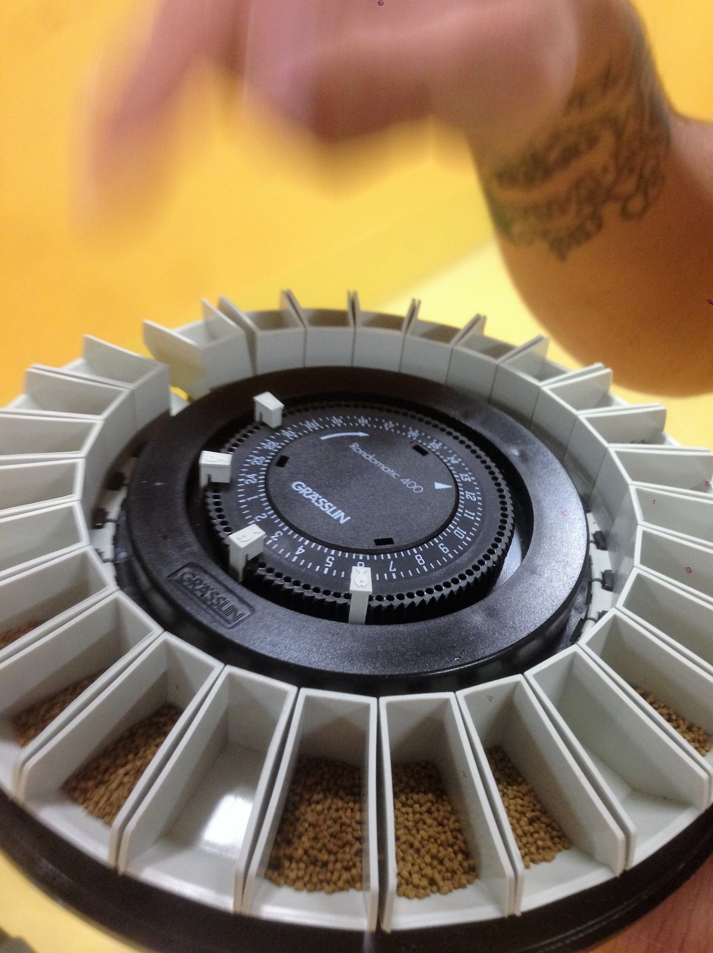
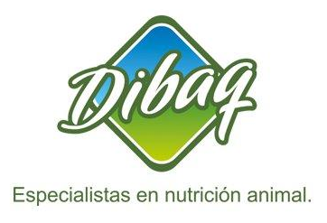
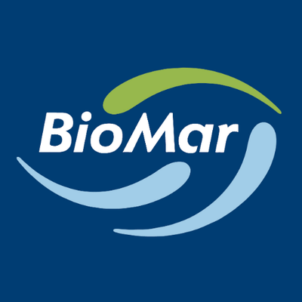
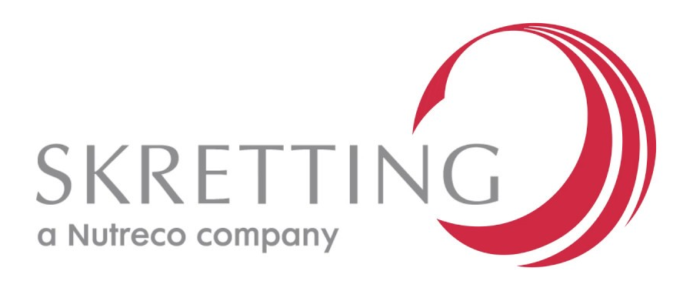
3. MARKETING COMPETITIVENESS
3. FEEDS
APROMAR participates in the meetings of the Animal Feed Area of the General Sub-Directorate of Livestock Production with the main representative associations of the sector.
APROMAR shares information with their members about raw materials for feeds, regulation and diets projects.
Innovation
Fish health and Fish Welfare
Feeds
Collective Bran “Crianza de Nuestros Mares”
Markets and Trade
Training
Economic Sustainability
International relations
Labour Relations
Communication
Promotion

Slide 14
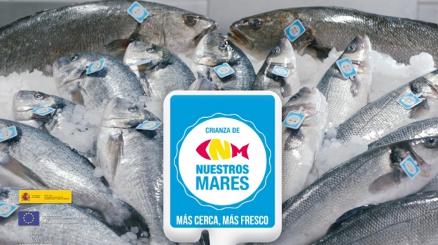
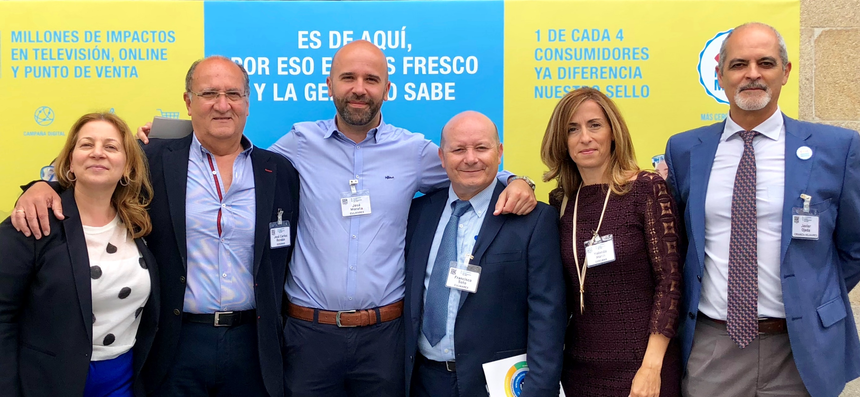
3. MARKETING COMPETITIVENESS
4. COLLECTIVE BRAND “CRIANZA DE NUESTROS MARES”
A group of the associated companies of APROMAR > consumers to recognize the fish from aquaculture farms of Spain.
There is a big marketing campaign every year in TV, radio, magazines, supermarkets, etc. to promote this brand.
The budget for the campaign comes from the associate members that participates involving the main aquaculture companies of Spain that produce sea bass, sea bream and meagre.
https://www.crianzadenuestrosmares.com/
Innovation
Fish health and Fish Welfare
Feeds
Collective Bran “Crianza de Nuestros Mares”
Markets and Trade
Training
Economic Sustainability
International relations
Labour Relations
Communication
Promotion

Slide 15
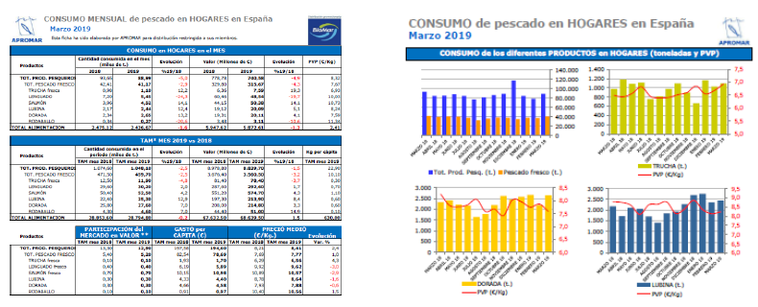
3. MARKETING COMPETITIVENESS
5. MARKETS AND TRADE
In APROMAR we prepare and distribute weekly or monthly markets reports for our members and we distribute reports from the Spanish Ministry or other organizations i. e. EUMOFA, GlobeFish, Eurofish, etc.
We are in constant communication with the Ministry and we send them weekly reports of the production of our associate companies.
APROMAR also participates in legal defense actions against international trade unfair competition.
Innovation
Fish health and Fish Welfare
Feeds
Collective Bran “Crianza de Nuestros Mares”
Markets and Trade
Training
Economic Sustainability
International relations
Labour Relations
Communication
Promotion

Slide 16
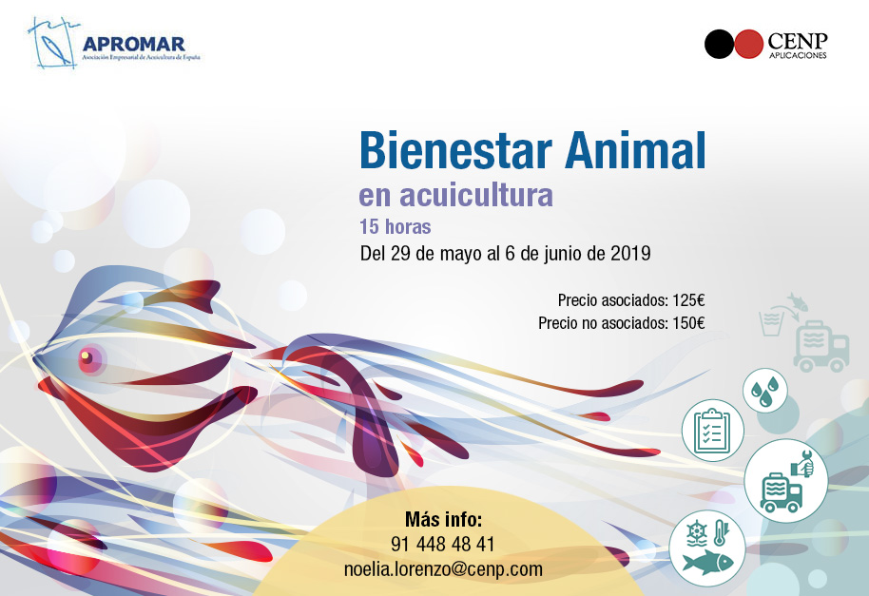
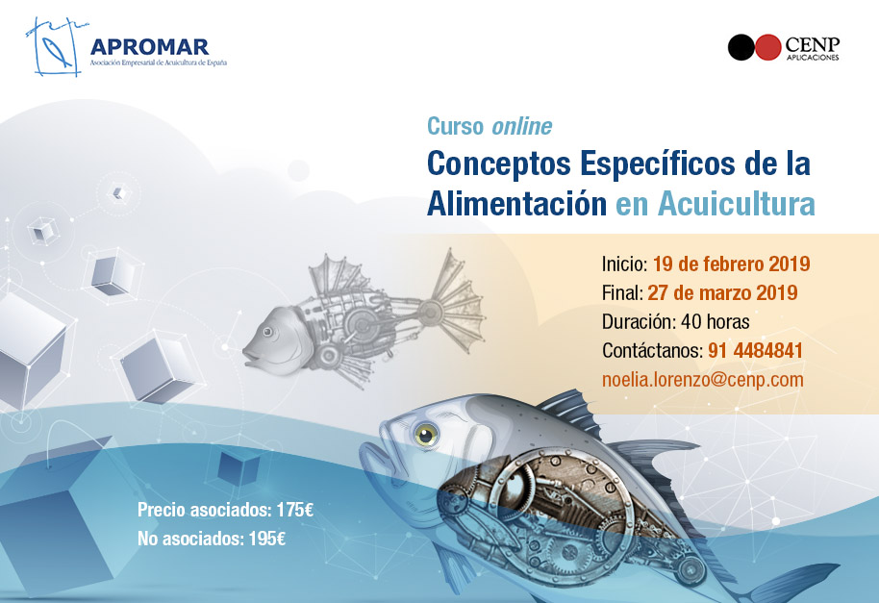
3. MARKETING COMPETITIVENESS
6. TRAINING
Every year APROMAR develops a Training Program of on-line courses for its associates / non-associates.
The subjects of these courses are varied: fish feeding, fish welfare, fish health, work safety, English, Microsoft Office, etc.
Innovation
Fish health and Fish Welfare
Feeds
Collective Bran “Crianza de Nuestros Mares”
Markets and Trade
Training
Economic Sustainability
International relations
Labour Relations
Communication
Promotion
http://cenp.davinchi.es/2019/APROMAR/areasFormativas2019.html

Slide 17

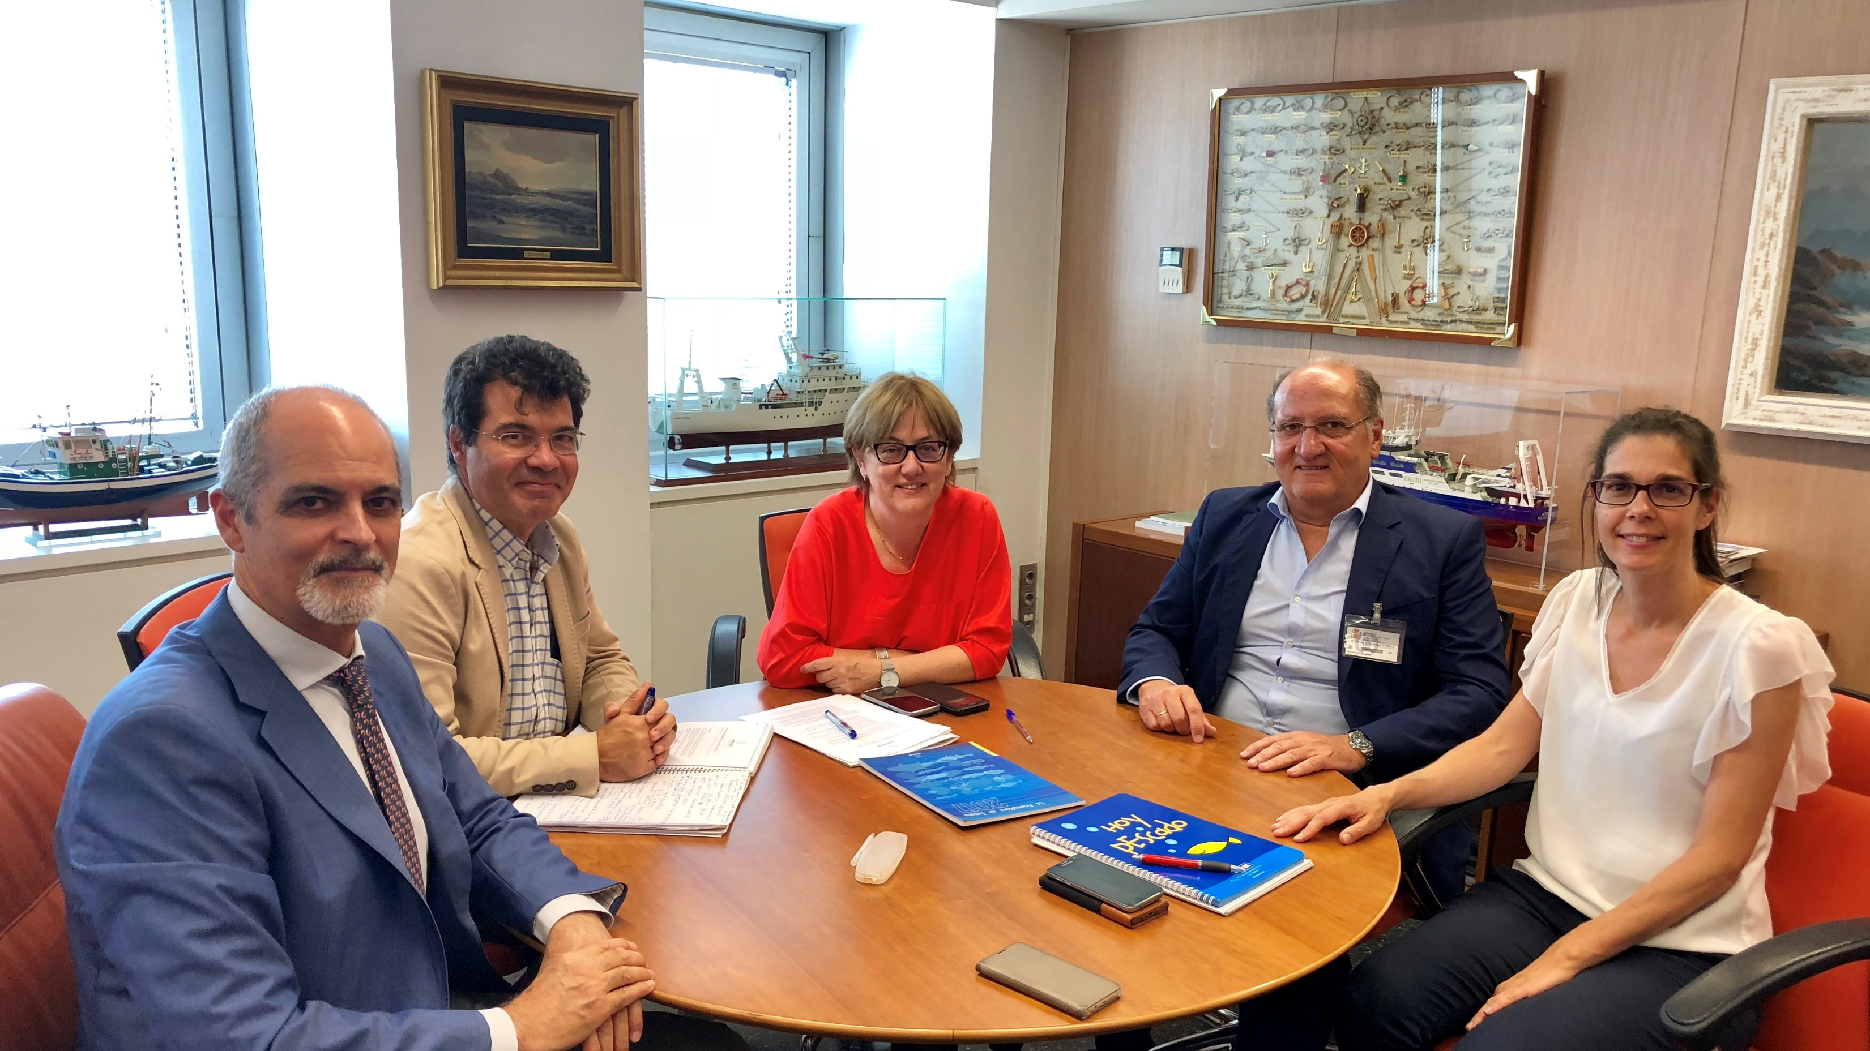
3. MARKETING COMPETITIVENESS
7. ECONOMIC SUSTAINABILITY
Alliances with public and private entities of the whole value chain of Spanish Aquaculture products.
Participating in different Working Groups: evaluating national legislation proposals, Committees aquaculture events, etc.
APROMAR also provides consultation and support for the Spanish Agricultural Public Insurance Scheme (ENESA-Agroseguro) and provide contact to private insurance companies.
Innovation
Fish health and Fish Welfare
Feeds
Collective Bran “Crianza de Nuestros Mares”
Markets and Trade
Training
Economic Sustainability
International relations
Labour Relations
Communication
Promotion

Slide 18
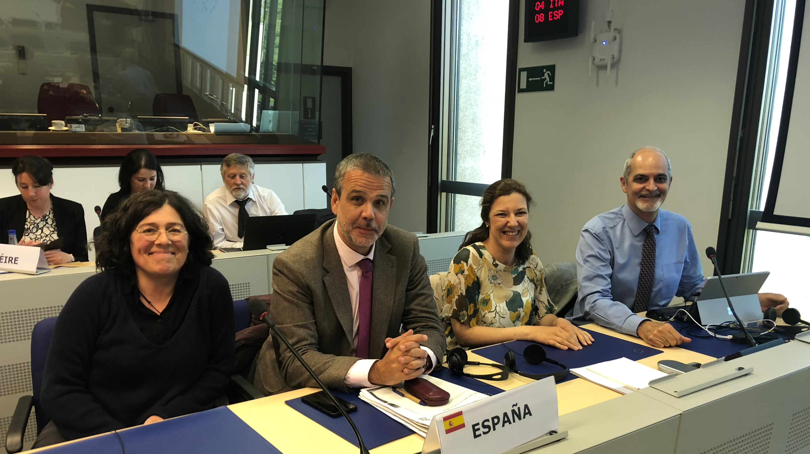
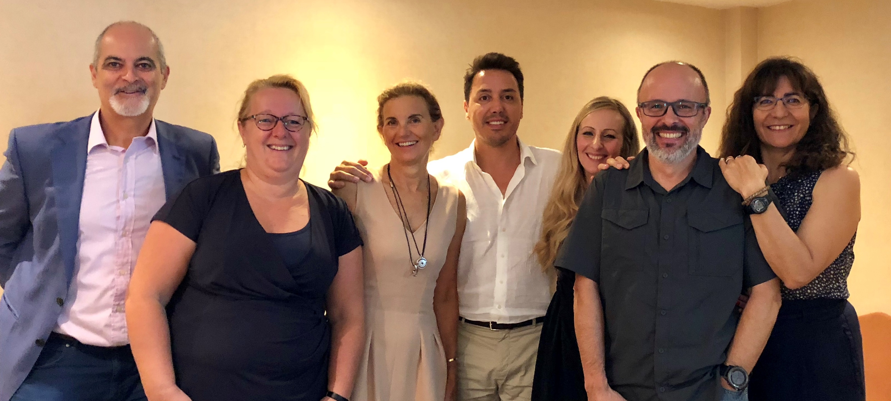
3. MARKETING COMPETITIVENESS
8. INTERNATIONAL RELATIONS
APROMAR participates in the main European Aquaculture organisations.
Important asset of the association to be participating in the European decisions and to be able to influence in the decisions
Javier Ojeda, APROMAR’s General Manager is the president of the Aquaculture Advisory Council (AAC) but also is an active member of MAC, FEAP, FAO, IUCN Fish/Aquaculture Working Groups.
Innovation
Fish health and Fish Welfare
Feeds
Collective Bran “Crianza de Nuestros Mares”
Markets and Trade
Training
Economic Sustainability
International relations
Labour Relations
Communication
Promotion

Slide 19
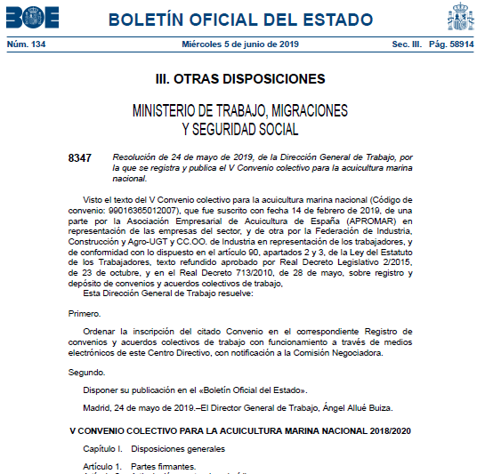
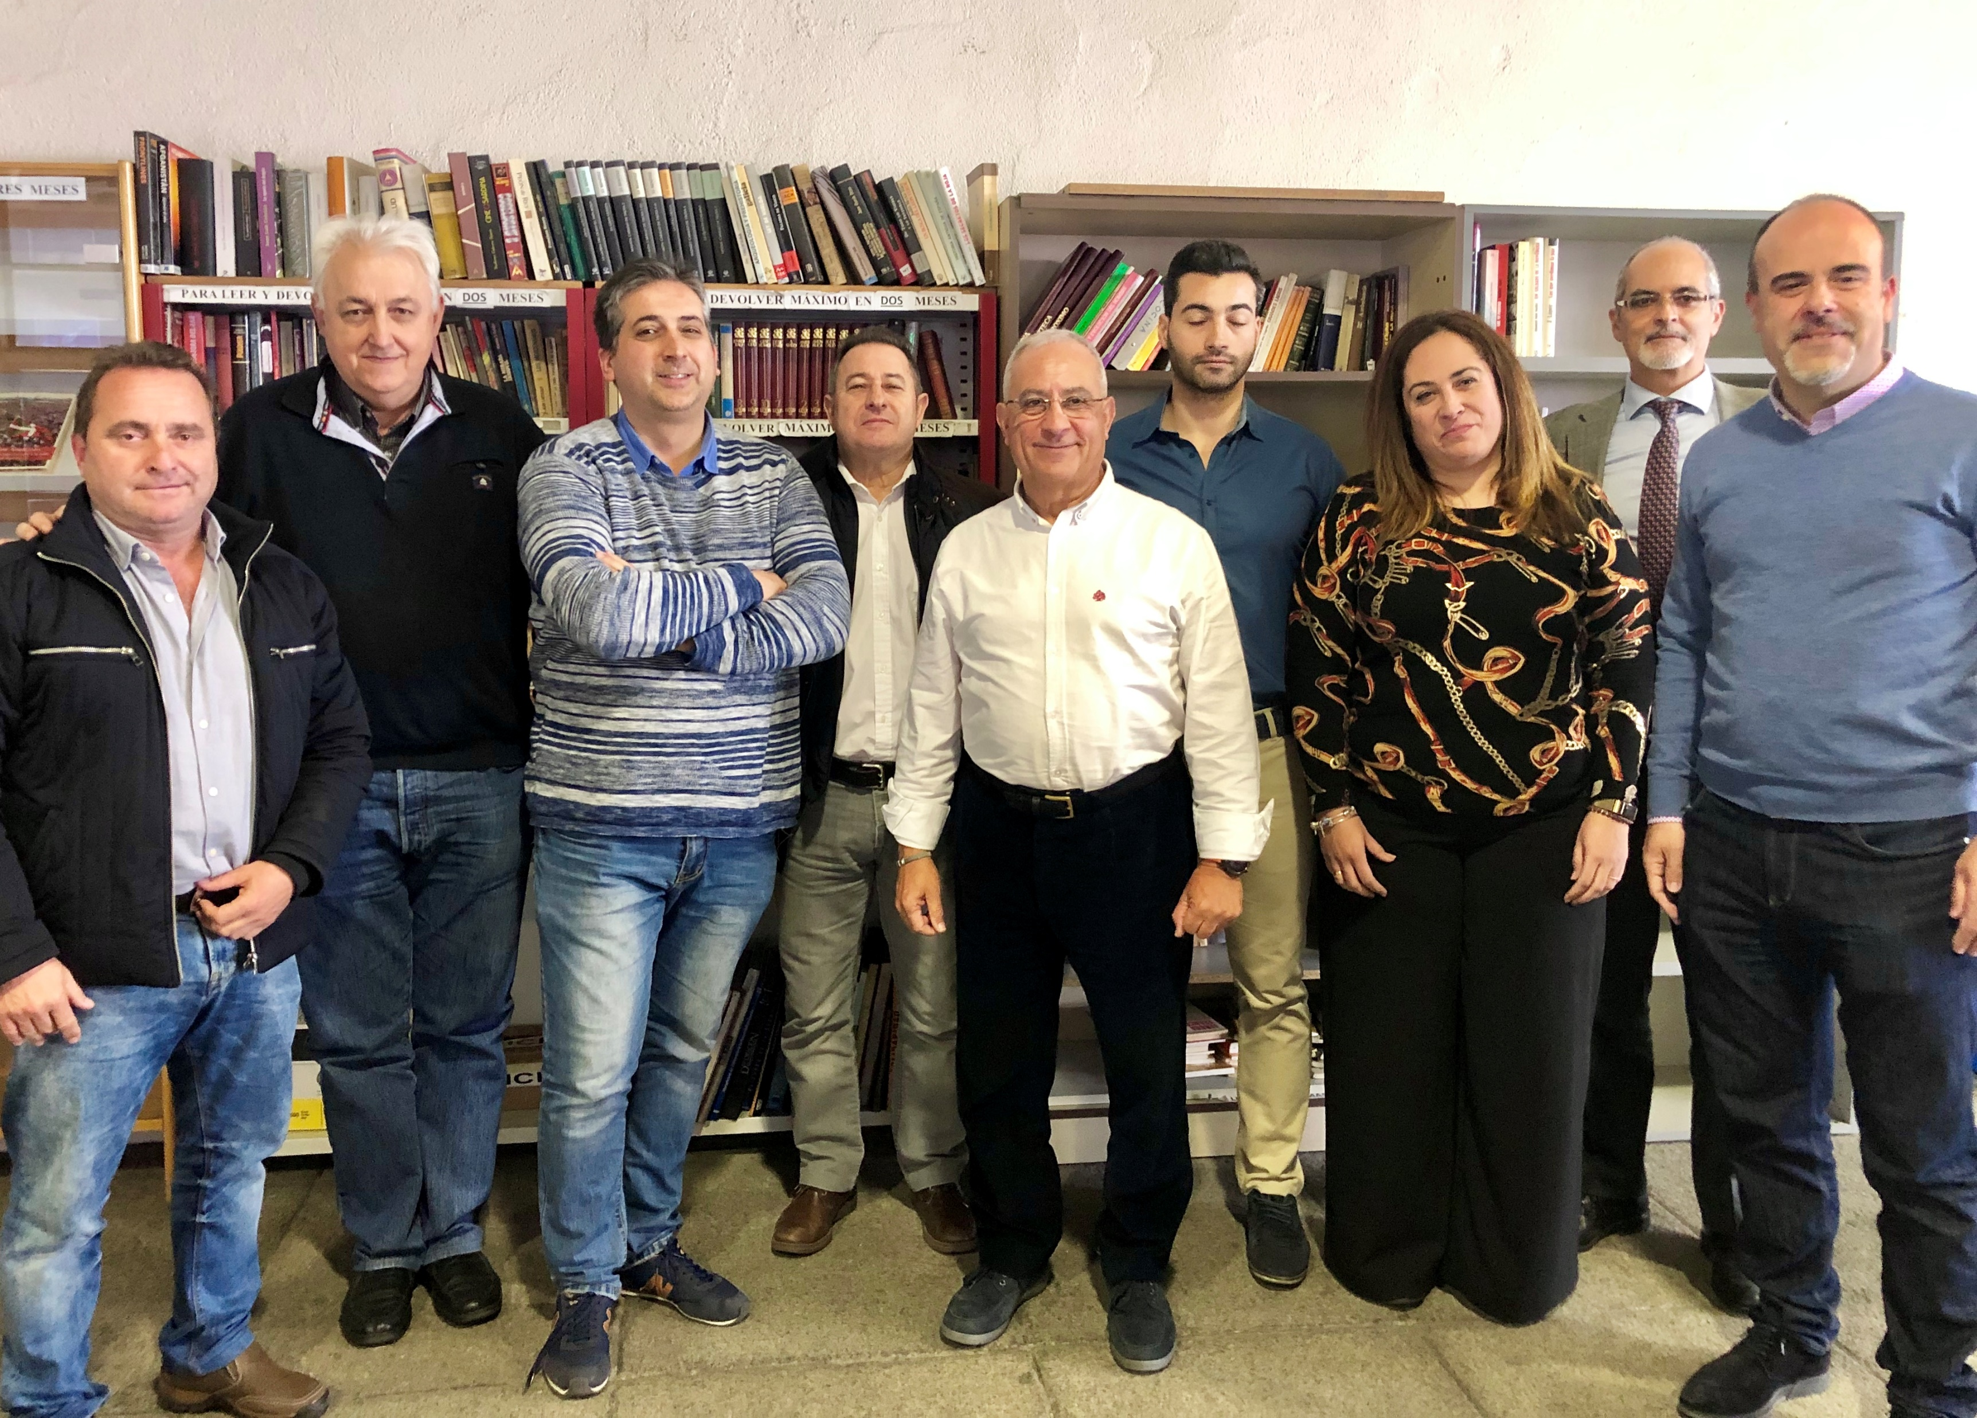
3. MARKETING COMPETITIVENESS
9. LABOUR RELATIONS
APROMAR cooperates with the State Foundation for Occupational Risk Prevention (Fund. PRL) through the developing of prevention and labour safety projects.
APROMAR is involved as a coordinator in the negotiation of the Collective Labour Agreements with the Labour Unions.
Innovation
Fish health and Fish Welfare
Feeds
Collective Bran “Crianza de Nuestros Mares”
Markets and Trade
Training
Economic Sustainability
International relations
Labour Relations
Communication
Promotion

Slide 20
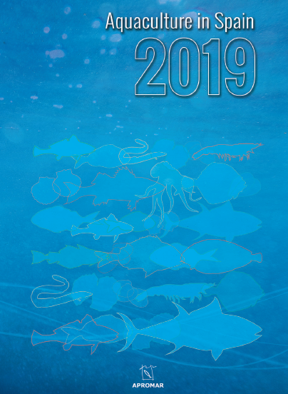

3. MARKETING COMPETITIVENESS
10. COMMUNICATION
Our main communication action is the publication of APROMAR’s Annual Report titled Aquaculture in Spain. You can download the 2019 edition in English from this link:
http://www.apromar.es/content/aquaculture-spain-2019
APROMAR also offers sound information to the media and society, reacts to negative news, release press news, participates in conferences and workshop and is active in Social Networks:
  -Facebook: @AsociacionAcuicultura
  -Twitter: @APROMAR_acui
  -LinkedIn: @APROMAR
  -Instagram: @APROMAR_acui
Innovation
Fish health and Fish Welfare
Feeds
Collective Bran “Crianza de Nuestros Mares”
Markets and Trade
Training
Economic Sustainability
International relations
Labour Relations
Communication
Promotion

Slide 21
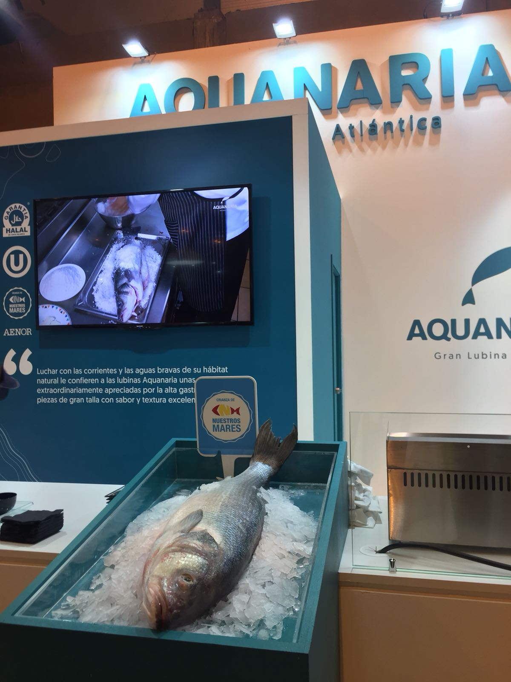
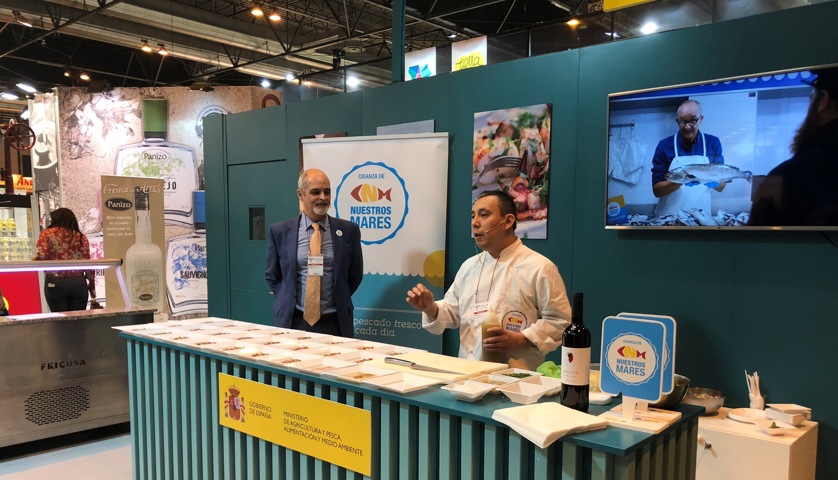
3. MARKETING COMPETITIVENESS
11. PROMOTION
In this measure we include all APROMAR actions related with the participation in Food Fairs and aquaculture products promotion events
Innovation
Fish health and Fish Welfare
Feeds
Collective Bran “Crianza de Nuestros Mares”
Markets and Trade
Training
Economic Sustainability
International relations
Labour Relations
Communication
Promotion

Slide 22
4. BENEFITS OF EU ASSOCIATIONS
Every single aquaculture association in Spain or Europe works in different ways so the benefits for their members are varied.
APROMAR is one of the most active fish farmer’s association in Spain and Europe.
The main assets of APROMAR are:
  1) The capacity to influence in the decisions of other organisations (public or private) → lobbying effectiveness
  2) To be a community to share ideas and create common opinions.
  3) To be an information hub and a source of sectorial knowledge.
  4) The possibility to act as enabler to achieve results.

Slide 23
4. BENEFITS OF EU ASSOCIATIONS
And the keys to the “success” of APROMAR are, on one hand, the Spanish aquaculture industry:
  1) The (relatively) large size and diversity of the Spanish aquaculture industry.
  2) The high representativeness of APROMAR within the industry.
  3) APROMAR’s good reputation and credibility.
On the other hand, the association has:
  1) An impartial and dedicated Board of Directors.
  2) Fair internal governance and transparency.
  3) Good communication (internal and external).
  4) Professional management team for the association.
  5) Internal quality discussions and agreements. (Toxic debates are left outside meeting rooms).

Slide 24

5. WORKING CONDITIONS
Negotiation of the Collective Labour Agreement
  APROMAR = Coordinator in the negotiation with the Labour Unions and is representing the industry
  Minimum standards on working conditions in aquaculture farms: working time, working shifts, salaries and workers categories
  In 2018 the negotiation of the V Collective Labour Agreement of Marine Aquaculture started and it has been signed in 2019
Promoting the best risk prevention practices through the cooperation with the State Foundation for Occupational Risk Prevention (Fund. PRL). At the moment, we are evaluating the risk of manual manipulation of feeds sacs
The previous years > projects about chemical products manipulation and diving risk.
APROMAR improves education and training courses.

Slide 25
6. NATURAL ENVIRONMENT ISSUES
The European Environment Framework Directives are:
  Habitats:
https://eur-lex.europa.eu/legal-content/EN/TXT/PDF/?uri=CELEX:31992L0043&from=EN
  Birds:
https://eur-lex.europa.eu/legal-content/EN/TXT/PDF/?uri=CELEX:32009L0147&from=EN
  Red Natura 2000:
https://eur-lex.europa.eu/legal-content/EN/TXT/HTML/?uri=LEGISSUM:l28076&from=ES
  Marine Strategy (marine waters):
https://eur-lex.europa.eu/legal-content/EN/TXT/PDF/?uri=CELEX:32010D0477(01)&from=EN
  Water (fresh waters):
https://eur-lex.europa.eu/resource.html?uri=cellar:5c835afb-2ec6-4577-bdf8-756d3d694eeb.0004.02/DOC_1&format=PDF
  Marine Spatial Planning is also important: https://eur-lex.europa.eu/legal-content/EN/TXT/PDF/?uri=CELEX:32014L0089&from=EN
Every company > Integrated Environmental Authorization (AAI) and an Environmental Monitoring Programme to be able to start producing.
Every Autonomous Communities has its own legal framework, the farming companies depending on their geographical situation will also have special environmental requirements.
The administrative procedure to obtain a new aquaculture licence last on average 4 years.

Slide 26
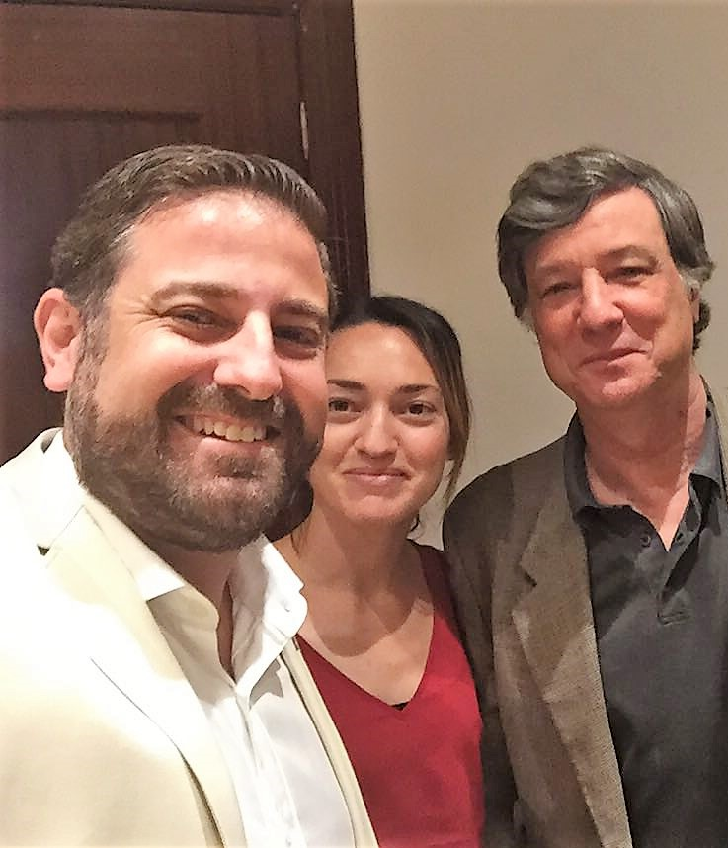
7. ANIMAL HEALTH
ADS = Association for Animal Health Protection (per region).
FEADSA = Federation of ADS (National). A non-profit organization. It is coordinated by an aquaculture veterinary called Dr. Jordi López.
  Each ADS with a veterinarian that freely accesses all farms in the region.
  Common fish health protection plans
  Communication of disease outbreaks between members.
  Communication with public authorities.
  FEADSA: Lobby and recommendations at national and EU level.
Recently involve in the elaboration:
  Regulation 2019/6 on veterinary medicines
  Regulation 2019/4 regarding the manufacture, marketing and use of medicated feed

Slide 27
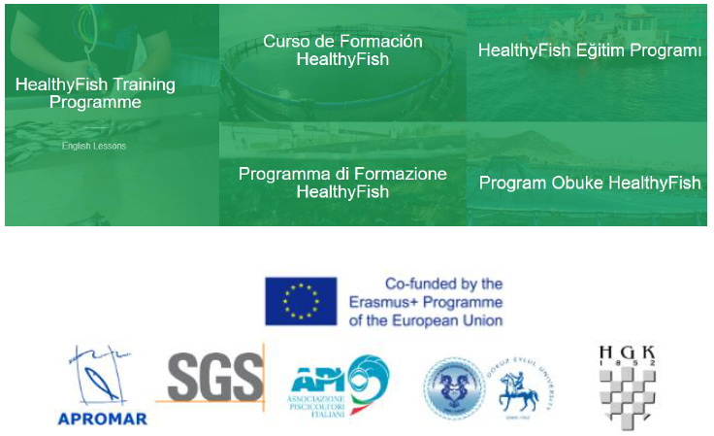
7. ANIMAL HEALTH
For APROMAR-FEADSA is very important to collaborate with other countries to improve fish health and welfare.
Fish welfare:
  Concern about fish sacrifice method.
  We are open to do research and projects to improve the best possible practice.
  Good chance of keeping the good work started with Izmir University in Healthy Fish Project.

Slide 28
8. INTERNAL SANCTIONS
We have a system of sanctions in our Production and Marketing Plan controlled by the management group.
It is considered a punishable action for example: poor presentation of the fish or its poor classification by size and size, incorrect labeling, abnormally market intervention, and the sanctions are economic depending on the severity or times that a punishable action is repeated.
It is difficult to punish a member.
In APROMAR it has not been necessary to do so.

Slide 29
9. FISH WELFARE
APROMAR agrees with FEAP Fish Welfare (may 2019) Resolution.
Fish farmers are the owners of their fish stocks and are responsible for them.
And FEAP position most relevant arguments are:
  FEAP promotes a holistic approach to fish welfare in which specific welfare issues must be considered alongside the limitations of the physical farming environment, workers safety, environmental protection, product quality and economic viability.
  FEAP understands that Good Practice at farm level is key to ensuring the adequate welfare of fish and, for this reason, promotes their uptake within the industry.
  FEAP recommends the promotion of further scientific research on fish welfare, in particular welfare indicators.
  When addressing fish welfare, the whole life cycle of the fish has to be addressed. Importance of adequate training for fish farm workers on this issue.
  Fish welfare should not contribute towards the un-level playing field with respect to other fish products, both imported into Europe or caught by fishing fleets.

Slide 30
10. HYGIENE
As we produce food for humans, the farms and also feeds producers have to follow the Food Laws > Hygiene = Food Law
strict framework is the way to guaranty a very high standard of fish products in Spain and Europe

Slide 31
11. LABELLING
The EU rules on food labelling and information to consumers are complex.
The main law is the Regulation 1169/2011 provision of food information to consumers that:
  Provides the basis for the assurance of a high level of consumer protection in relation to food information, taking into account the differences in the perception of consumers and their information needs whilst ensuring the smooth functioning of the internal market.
  Establishes the general principles, requirements and responsibilities governing food information, and in particular food labelling.
  It lays down the means to guarantee the right of consumers to information and procedures for the provision of food information.
  Applies to food business operators at all stages of the food chain, where their activities concern the provision of food information to the final consumer.
  But it also applies the Food laws and others.

Slide 32
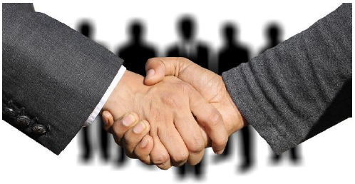
12. COLLABORATION
APROMAR is open to collaborate with other Mediterranean associations.
The possible fields are:
  1) Communication to society.
  2) Fish health.
  3) Market intelligence.
  4) The GSI (https://globalsalmoninitiative.org/) as an example to follow for bass and bream.

Slide 33
THANK YOU!
Garazi Rodríguez Valle
Head of Projects Section
garazi@apromar.es
JAVIER OJEDA
General Manager
ojeda@apromar.es
Sept’19

